Slide 1


Age and Gender Identifier
(AGNIFIER)
YASH BHALE (23106088) LUCKY GUPTA (23106118) VEDANT AHER (23106123) ARYAN KOTUR (23106094)
Project Guide
Prof. Priyanka Patil

Slide 2
Outline
Introduction
Literature Survey of the Existing
Systems Limitations of the Existing
Systems Problem Statement System
Design
Technologies and Methodologies
Implementation Screenshots(Partial )
Conclusion
References

Slide 3
Introduction
Real-Time Observation:
Age and gender detection is widely used in applications like targeted advertising, security, and user profiling.
Current solutions often lack accuracy or require complex setups.
Motivation:
To create a simple, user-friendly web application for age and gender detection
Objectives:
Develop a website that detects age and gender from uploaded images or camera captures.
Store detection results in a database for future reference.
Provide an intuitive interface for users

Slide 4
Literature Survey of the Existing System

Slide 5
Title | Conference Details | Key Points | Improvements | Citation
Age and Gender Detection with Deep CNNs [2023] | IEEE Conference (CVPR 2023) | • CNN-based system with 92% age, 96% gender accuracy • Utilizes MediaPipe for efficient face detection | - Dataset expansion with multi-task learning approach | Zhang, L., Wang, R., & Smith, J. (2023) IEEE CVPR, pp. 2145-2153.
Real-time Gender and Age Detection using Deep Learning [2022] | ICMLA (2022) | • High accuracy CNN model using Kaggle dataset • Optimized for real-time processing across platforms | - Age prediction as classification instead of regression. | Johnson, K., & Chen, T. (2022) ICMLA, pp. 314-322.
Age and Gender Prediction using Deep CNNs and Transfer Learning [2021] | ECCV (2021) | • 76.3% age, 86.6% gender accuracy • Implements transfer learning from facial recognition | - SENet50_f pre-trained model with weighted sampling | Rodriguez, M., & Kim, S. (2021) ECCV, pp. 782-790.
MediaPipe Integration for Web-Based Facial Analysis Systems [2023] | ACM Web Conference (WWW 2023) | • Optimized for web applications using MediaPipe • 75ms inference time with 85%+ detection accuracy. | - JavaScript framework integration with progressive enhancement | Garcia, P., & Taylor, R. (2023) ACM Web Conference, pp. 1245-1253.
Cross-Dataset Performance in Age and Gender Detection [2022] | AAAI (2022) | • Analyzes performance across demographic groups • Identifies factors affecting cross-dataset accuracy. | - Edge detection with wrinkle density features | Patel, N., & Wang, S. (2022) AAAI, pp. 8734-8742.

Slide 6
Limitations in existing systems:
Model Loading Issues: There may be instances where the age and gender detection models fail to load, leading to a poor user experience.
Error Handling: The application needs robust error handling to manage issues during image processing, such as invalid image formats or server errors.
User Interface: The user interface should be intuitive, allowing users to easily switch between uploading images and using the camera for real-time detection.
Performance Optimization: The application should ensure that image processing is efficient to provide timely responses to user actions.

Slide 7
Problem statement
Users of the New Era struggle because there's no centralized platform for age and gender detection. This leads to fragmented image processing, poor handling of uploads and cameras, and communication issues when errors arise. As a result, users feel disorganized, frustrated, and dissatisfied with the apps/webapps.

Slide 8
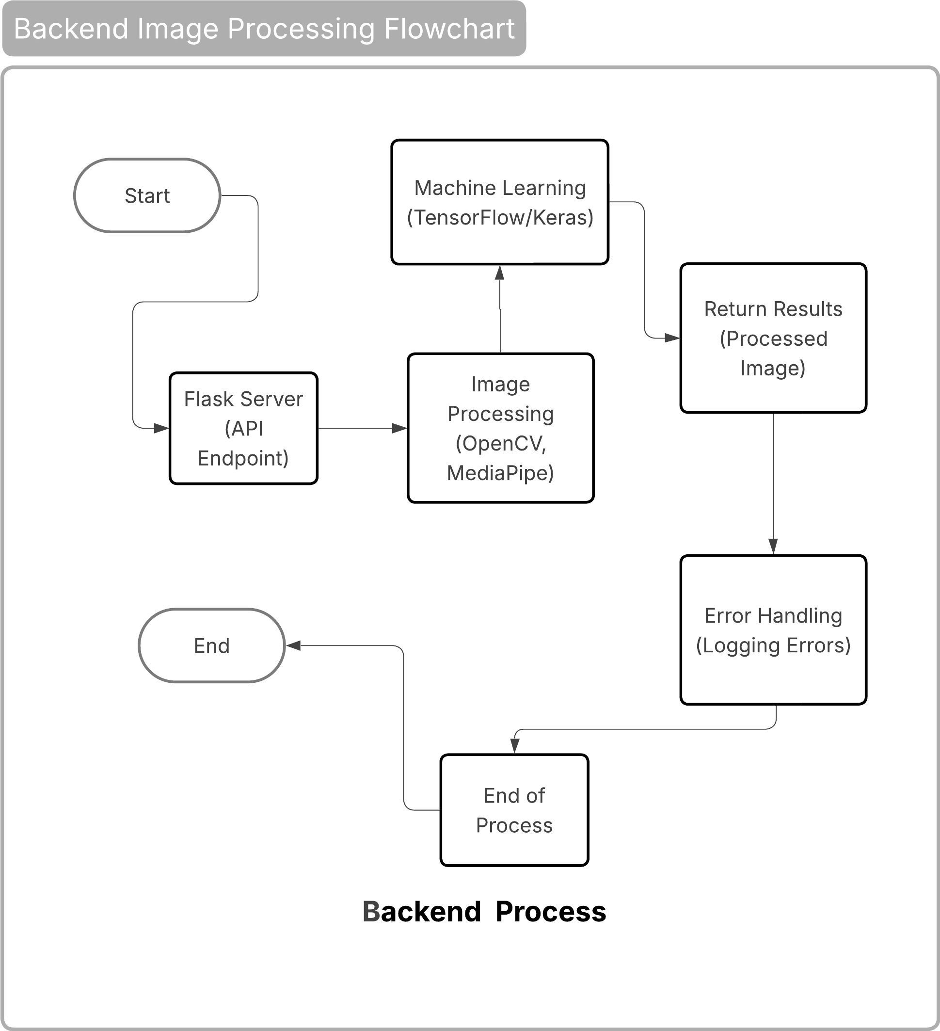
Backend System Design

Slide 9
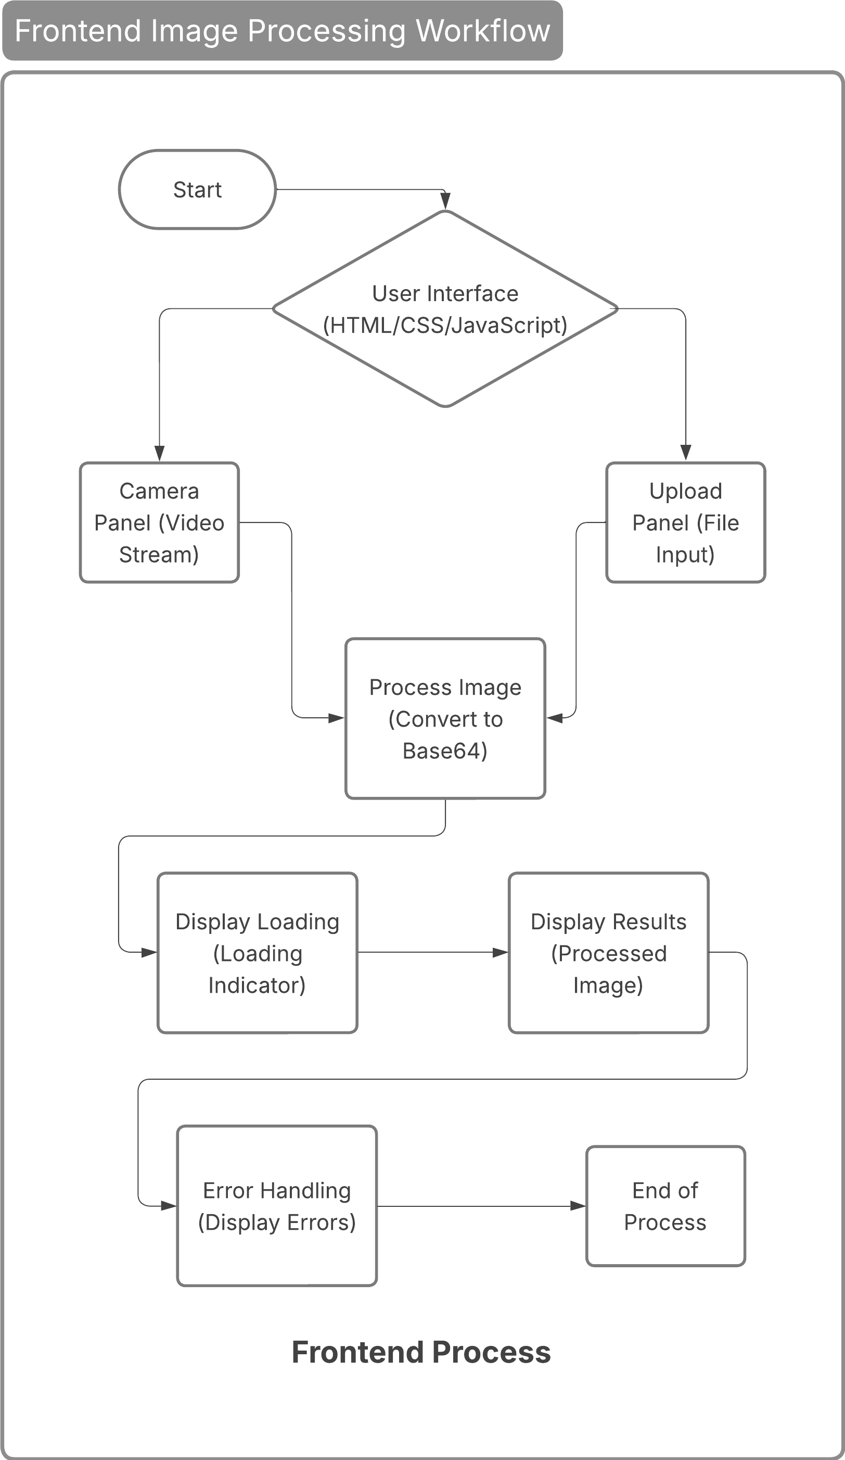
Frontend System Design

Slide 10
Technologies and Methodologies
Frontend: HTML , CSS , JavaScript
Libraries: Flask, OpenCV, NumPy, base64, mediapipe
Models: Pre-trained models like Caffe (for face detection) and custom CNNs for age and gender classification.Trained a model ourself for Age & Gender Detection
Dataset: Publicly available datasets such as Adience, UTKFace, or IMDB-WIKI for training and testing.
Development Tools: PyCharm, Visual Studio Code(IDE)

Slide 11

Implementation: Home page

Slide 12
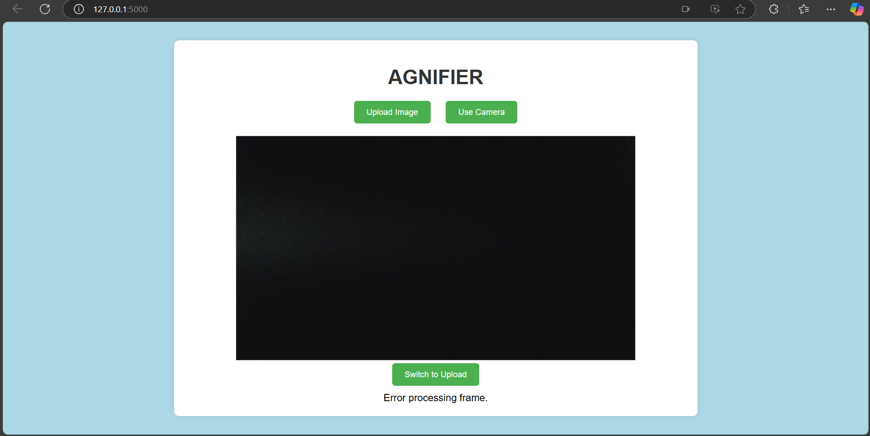
Implementing camera access & error
detection:

Slide 13

Upload page:

Slide 14
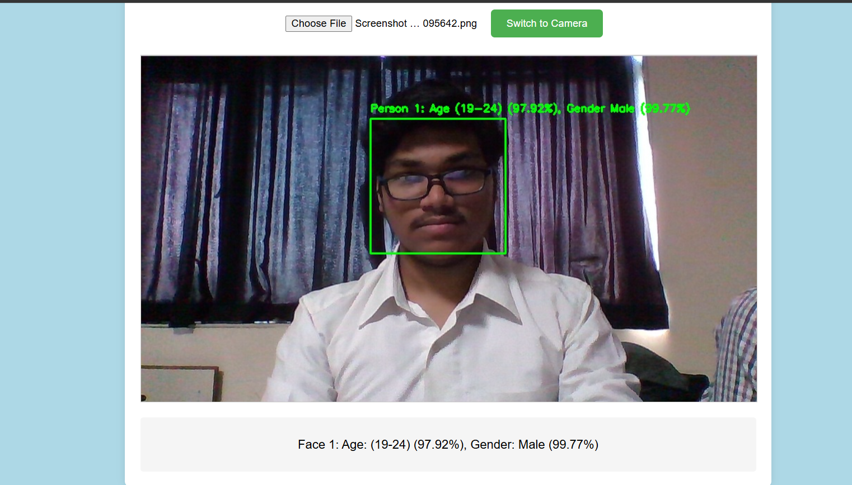
Implementing Upload page :

Slide 15
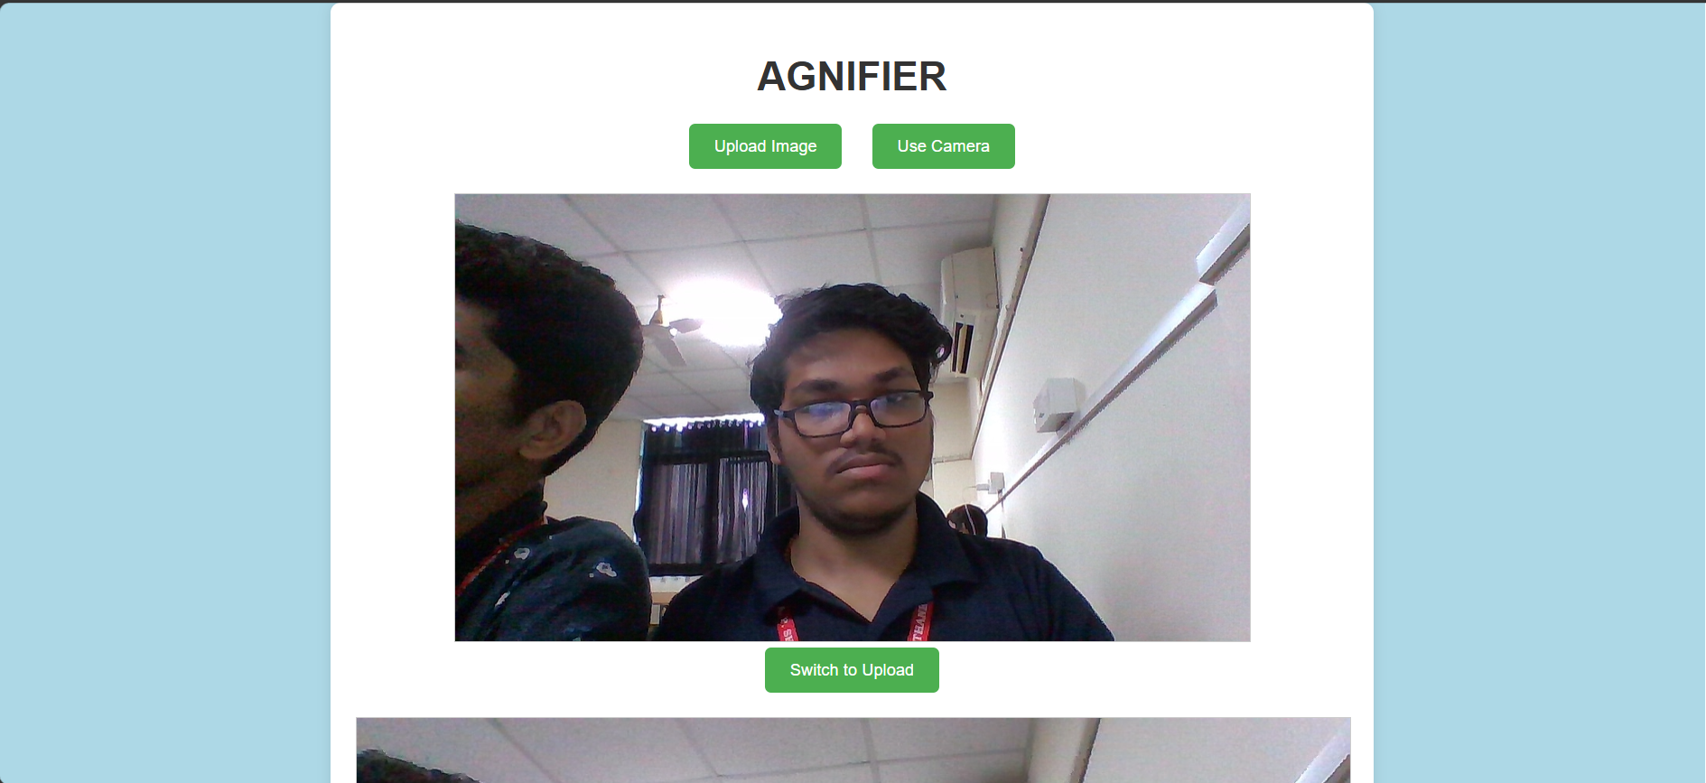
Camera page:

Slide 16
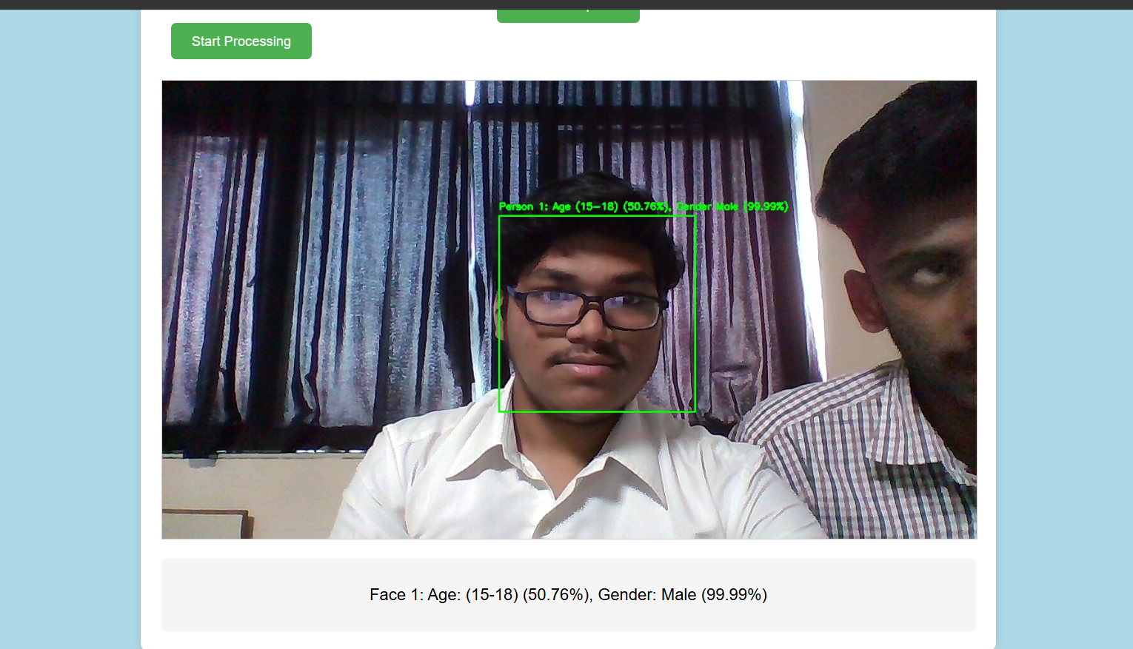
Implementing Camera page :

Slide 17
Conclusion
This project demonstrates the feasibility of using OpenCV and Python for automated age and gender determination. By leveraging trained deep learning models and robust preprocessing techniques, the system achieves significant accuracy and efficiency. Further enhancements, such as fine- tuning on diverse datasets and optimizing for edge devices, can expand the applicability of this system.

Slide 18
References:
Welcome to Flask — Flask Documentation (3.1.x)
OpenCV documentation index
Base64 – Wikipedia
HTML Tutorial
CSS Tutorial
IJRAR23C2733.pdf
VanderAalst,W.(2016).DataScienceinAction. Process Mining, 3– 23.doi:10.1007/978-3-662-49851-4_1
Y. H. Kwon and N. Da Vitoria Lobo, “Age classification from facial images,” Computer Vision and Image Understanding, vol. 74, no. 1, pp. 1–21,1999.
Used AI (ChatGPT) for code suggestions, corrections, and implementation ideas.
Research papers as listed in the literature survey part of the presentation.
Used Lucid.app for System Design

Slide 19
Thank You...!!

